Slide 1






Homework 9 (Due: 5/22)
Perform contrast enhancements for a color image.
(1) Input a RGB color image;
(2) Scale its RGB pixel values to rgb values,
where
(3) Transfer rgb pixel values into hsv values;
(4) Apply the histogram equalization algorithm to
the v component to obtain the component;
(5) Transfer the values into values;
(6) Scale values to values,
where
(7) Output the RGB and color images.

Slide 2
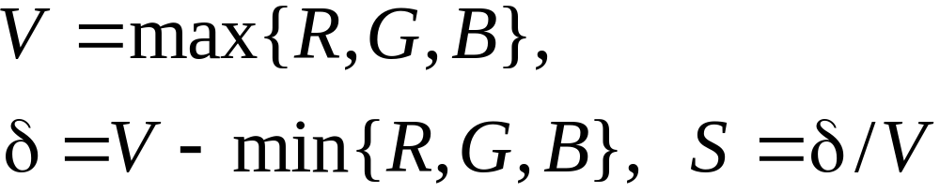
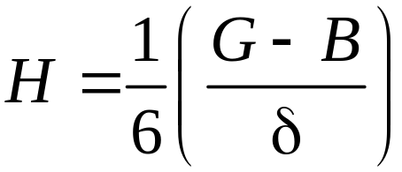
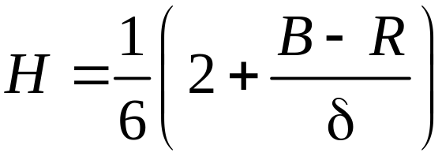
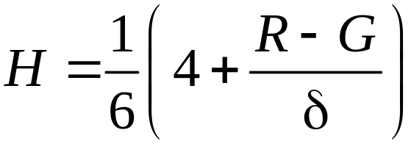
RGB HSV
If V = R, then
If V = G, then
If V = B, then
If H ends up being negative, add 1.
If (R,G,B) = (0,0,0), then (H,S,V) = (0,0,0)

Slide 3
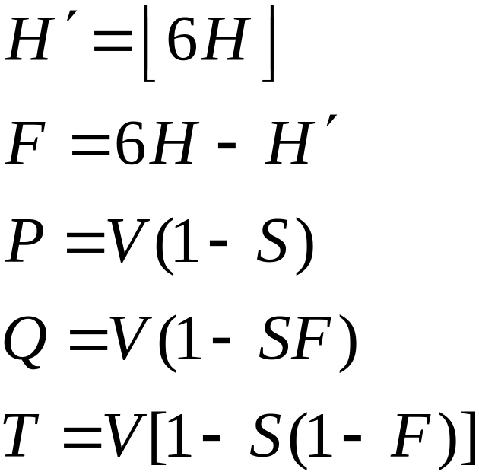
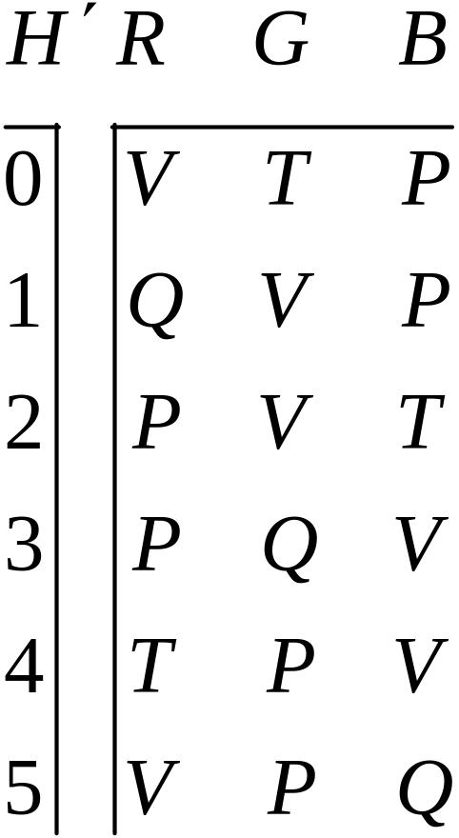
HSV RGB

